Slide 1
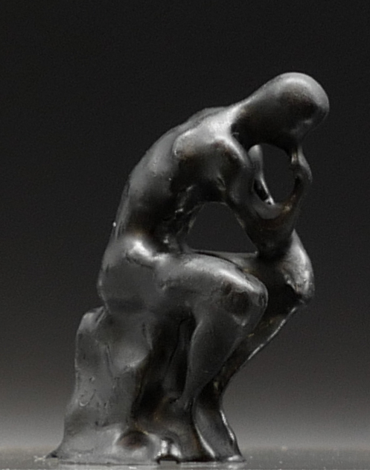

Slide 2

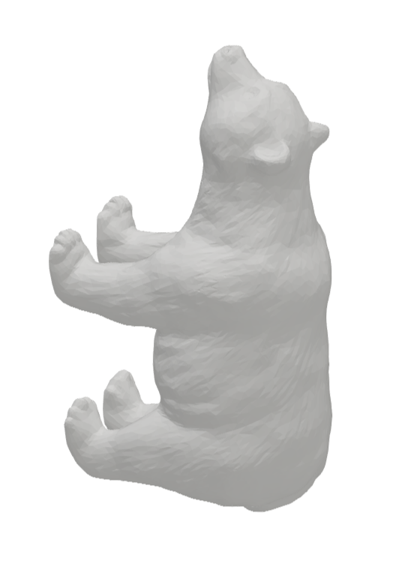
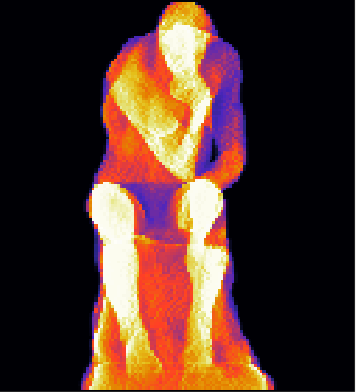
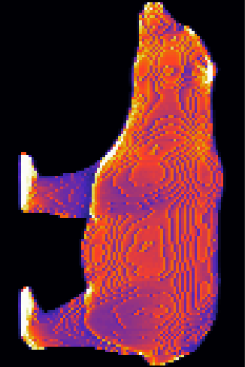
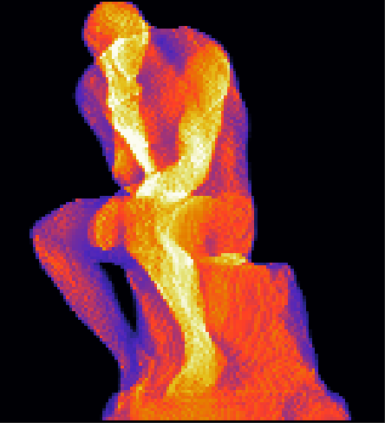
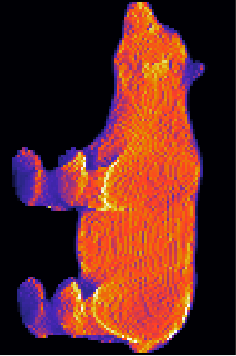
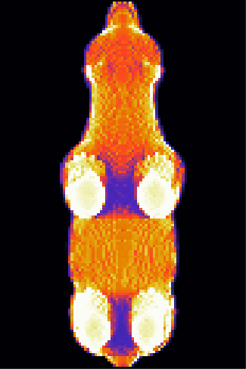
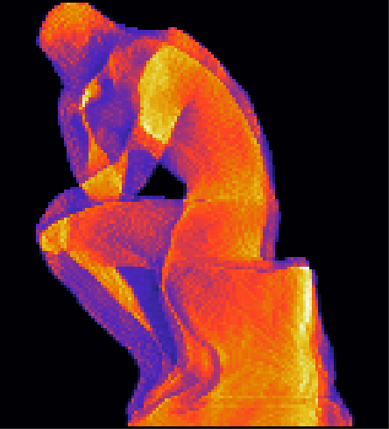
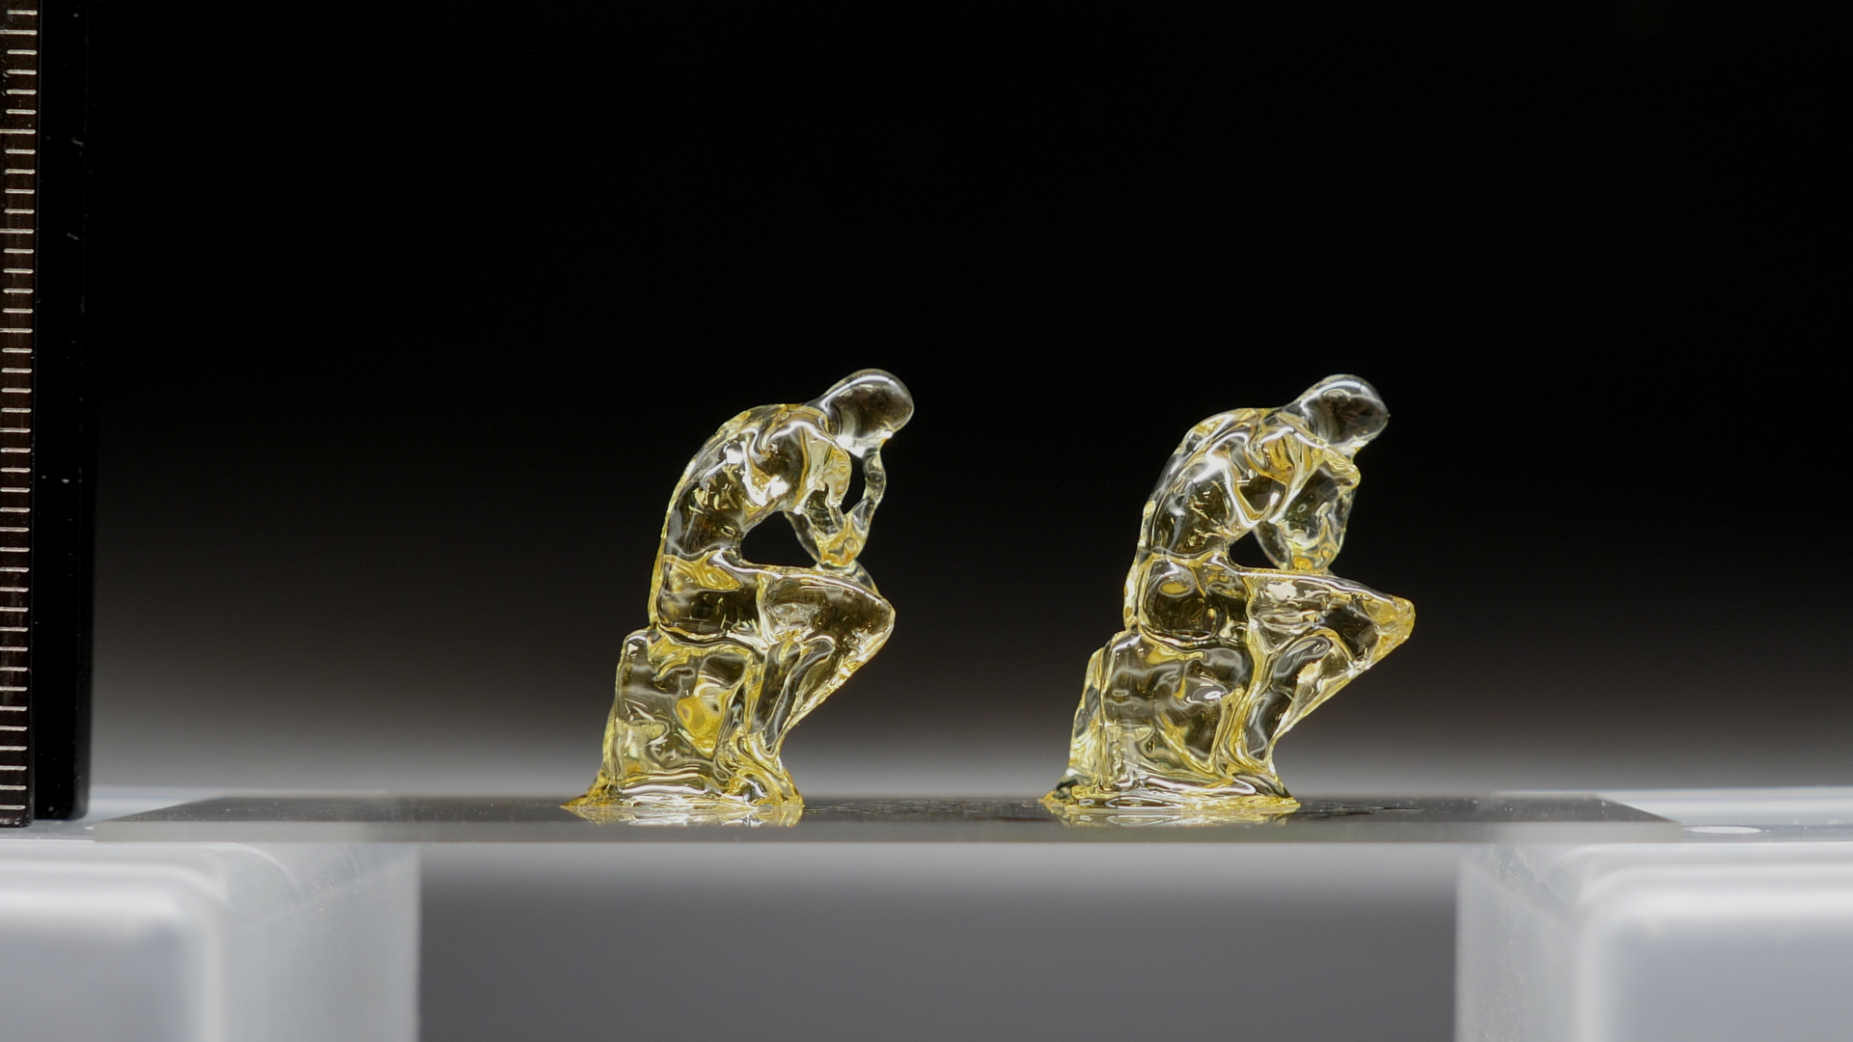
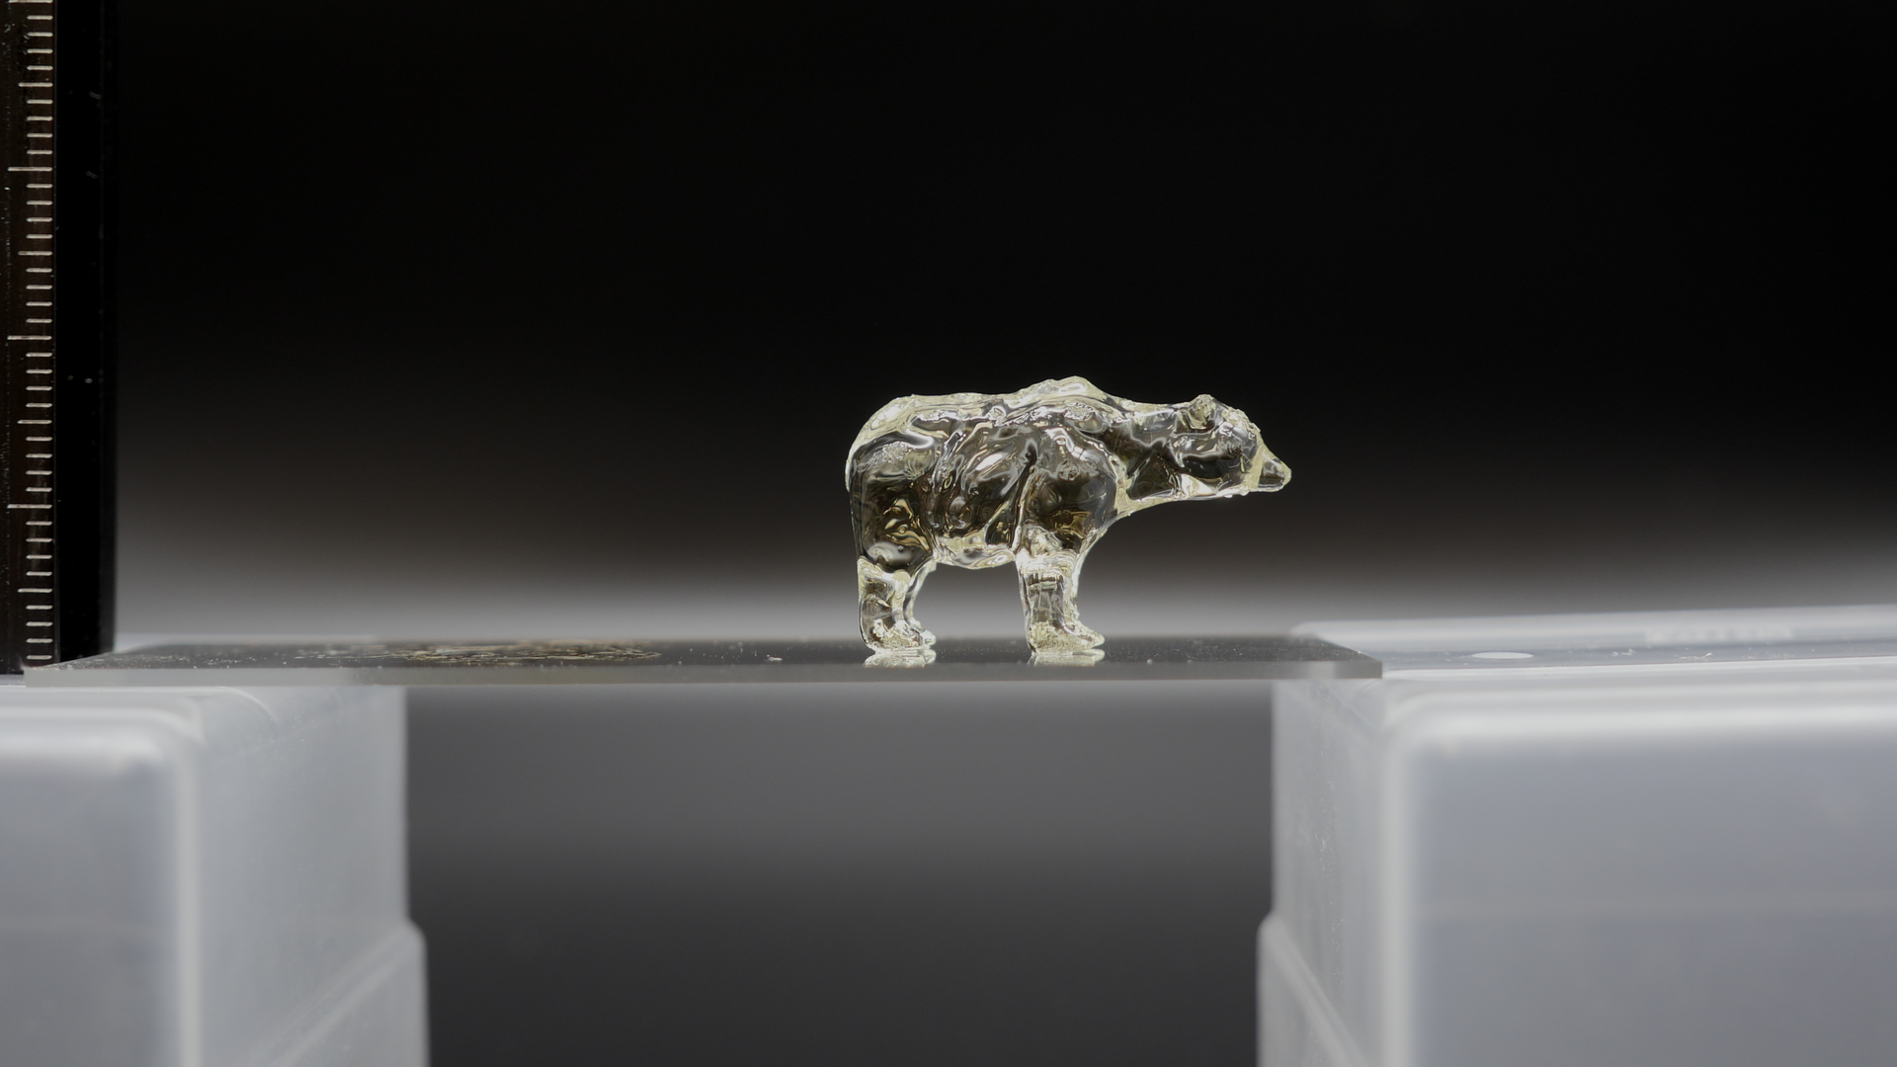






CAL projection generation and optimization
$$θ_{i}$$
$$θ_{i}$$
$$θ_{j}$$
$$θ_{j}$$
$$θ_{k}$$
$$θ_{k}$$
CAL Printing
5 mm
5 mm

Slide 3
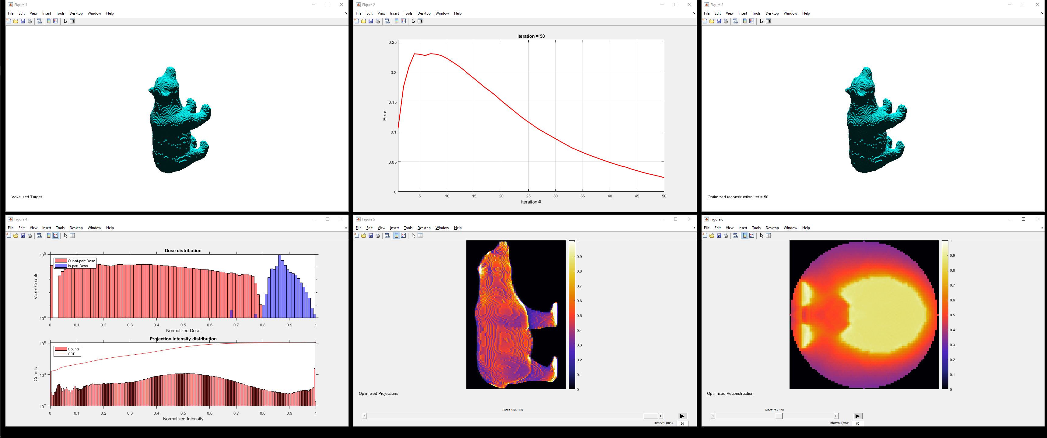
A
B
C
D
E
F

Slide 4
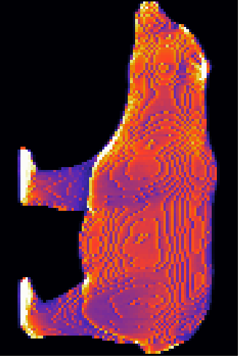
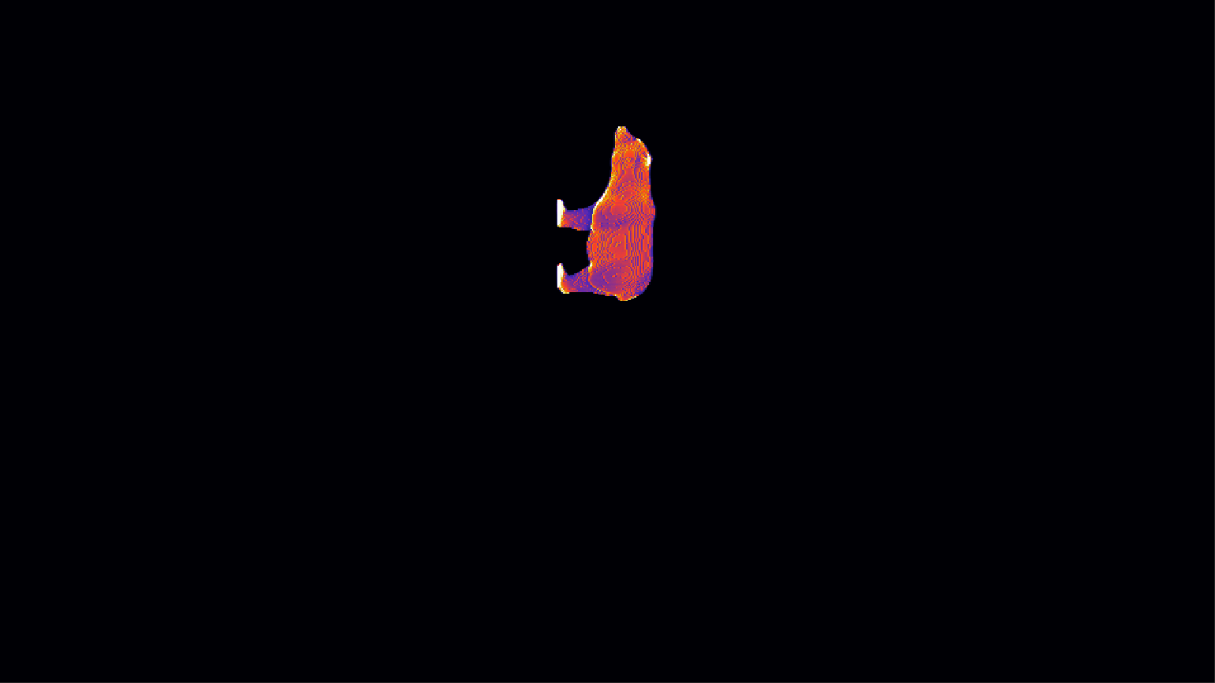


$${\text{proj}}_{θ_{i}}$$
$${\text{image} \text{set}}_{θ_{i}}$$

Slide 5


$$θ$$
rotate
image_height
t_offset
z_offset
array_offset
image_width

